Slide 1
LI: Introduce Water in the World topic by starting with the classification of environmental resources. SC: Students can define what a natural resource is. Students to understand the difference between renewable and non-renewable resources.

Slide 2
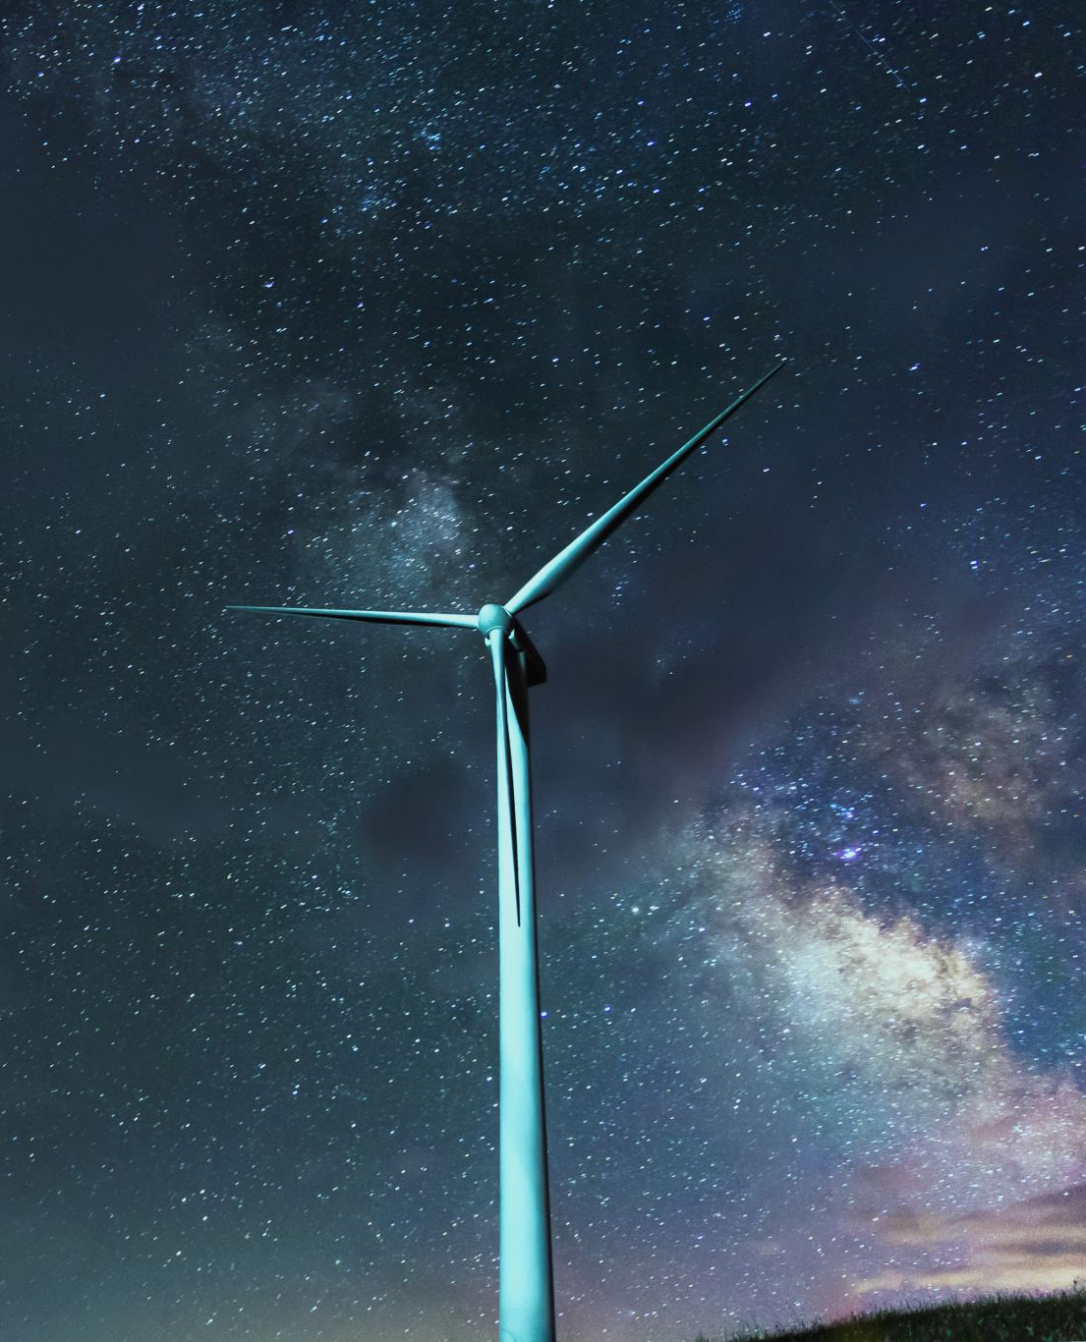
Natural Resources
These are things we take from the Earth that are used by us. They can be divided into 3 categories- renewable, non-renewable and continuous.
Can you think of an example?
Notes:
What is a natural Resource?
The most common categories of natural resources are minerals (such as gold and tin) and energy resources (such as coal and oil).
The air, forests and oceans can also be classified as natural resources.
Natural resources change in value over time, depending on what a society most needs or considers most valuable.

Slide 3
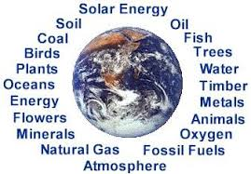
Natural Resources
Notes:
What is a natural Resource?
The most common categories of natural resources are minerals (such as gold and tin) and energy resources (such as coal and oil).
The air, forests and oceans can also be classified as natural resources.
Natural resources change in value over time, depending on what a society most needs or considers most valuable.

Slide 4
Renewable Resources
Usually living resources
They can reproduce or re-stock themselves
BUT, they only exist if they are not being used faster then they can replenish themselves.
Can you think of any examples?

Slide 5
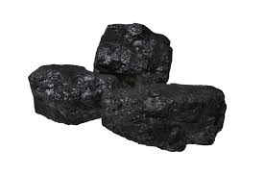
Non-Renewable
Once used, they are gone and cannot be replaced.
OR they cannot be replaced in our lifetime quickly enough to meet our needs.
Coal is considered a non-renewable resource as it takes millions of years to form.

Slide 6
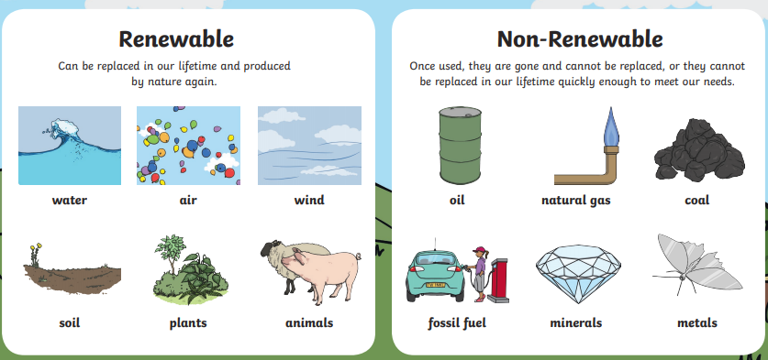

Slide 7
Continuous Resources
A continuous resource is a natural source of energy that won’t run out or be depleted no matter how much of it we use.
Examples: Solar Power and Wind Power.
The sun and the wind will not run out, be depleted or stop occurring for many thousands of years

